Slide 1
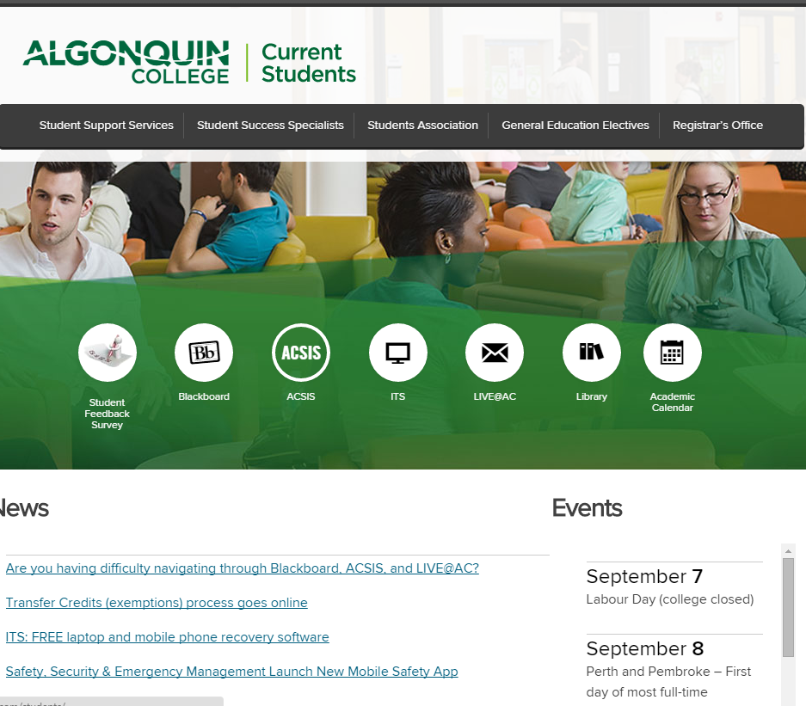
ACSIS

Slide 2
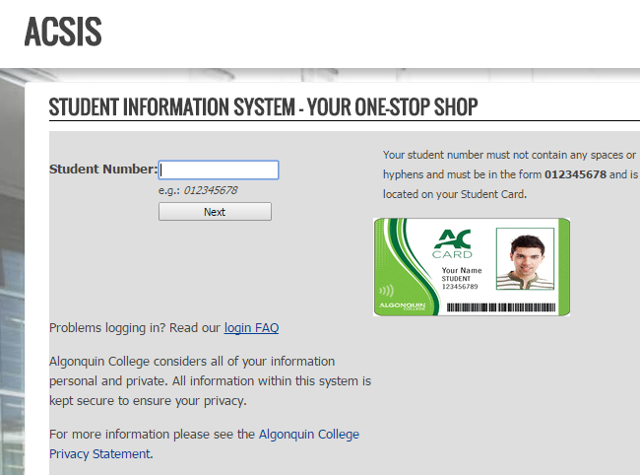
ACSIS http://www.algonquincollege.com/current-students

Slide 3
What is ACSIS? Algonquin college student information system
The Algonquin College Student Information System (ACIS) represents an online version of the Registrar's Office.
It provides you with a variety of online services:
Apply for bursaries
Apply for an exemption (Transfer of Credit)
Order transcripts (including official copies)
Get your network ID and password information
View timetable, grade and final assessment week information
Find your locker

Slide 4
Algonquin college Student information System
ACSIS is the Algonquin College Student Information System.
This article is intended for all students at all campuses.
Answer
The Algonquin College Student Information System (ACSIS) represents an online version of the Registrar's Office.
ACSIS provides you with a variety of online services. It is easy to use, convenient, and fits perfectly with your busy schedule. Why wait when you can do what you need online right now?
Apply for bursaries
Apply for an exemption (Transfer of Credit)
Order transcripts (including official copies)
Get your network ID and password information
View timetable, grade and final assessment week information
Find your locker
Access Blackboard
Drop/Add/Transfer courses
Change course sections
Select General Education electives
View encumbrance status and the reason for encumbrance
Update your personal information
Declare Continuing Education programs
Register for the online Graduate programs
View and print your official tuition tax receipts (T2202A)
You can login to ACSIS 24 hours after the Registrar's Office has your information, including your date of birth. For more information on the RO, see Where is the Registrar's Office?

Slide 5
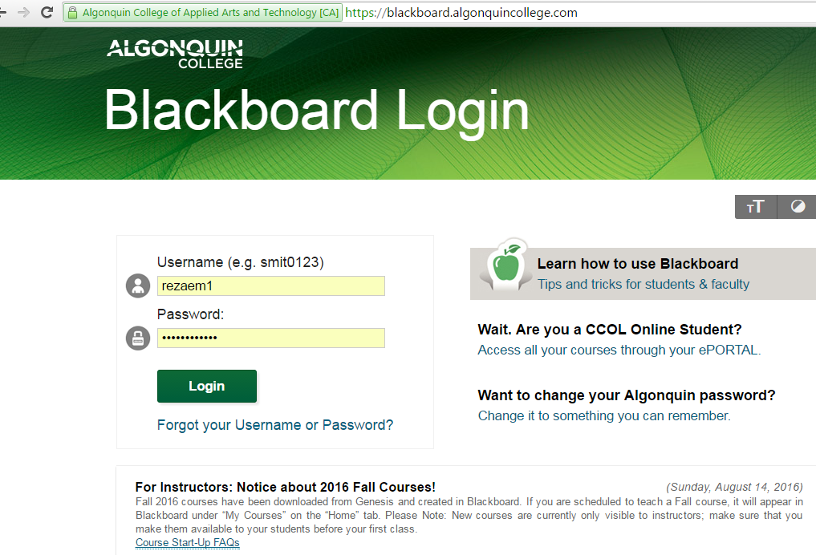
What is Blackboard?

Slide 6
What is BB? online.algonquincollege.com
Announcements
Digital recourse
Do quizzes
Course documents
labs, lectures
Course information
course outline
Check the grades

Slide 7
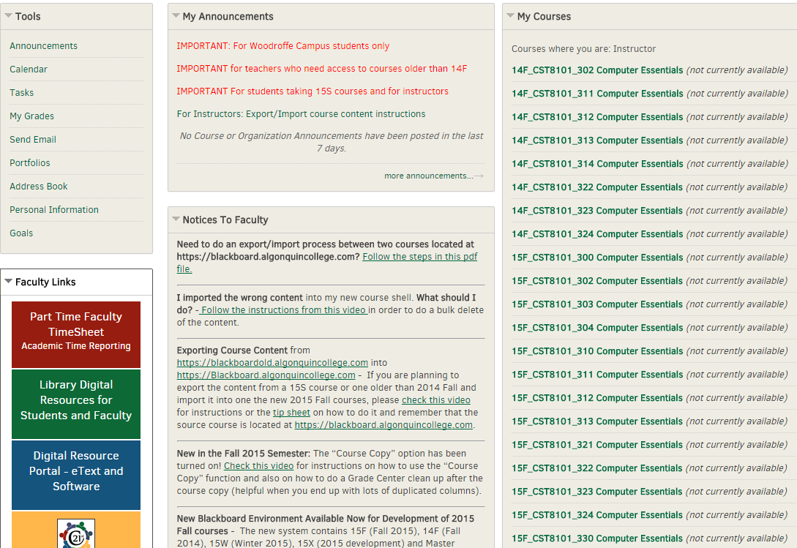

Slide 8
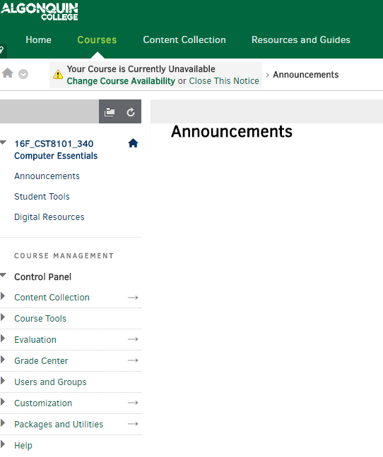

Slide 9
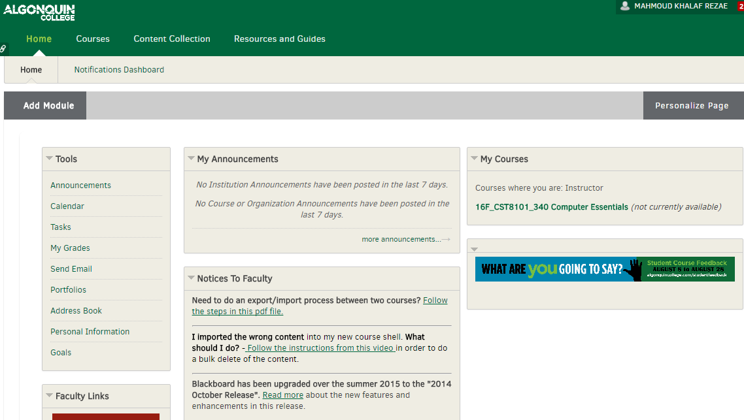
Students BB

Slide 10
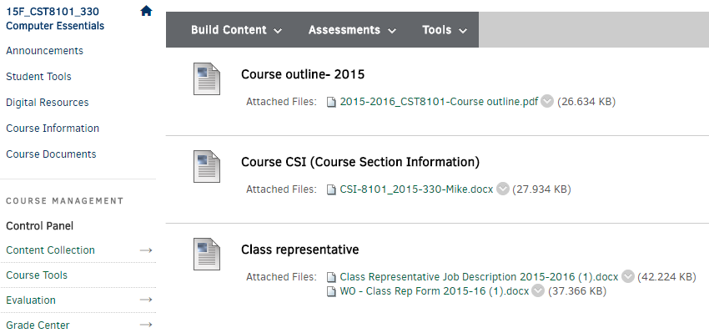
Course information

Slide 11
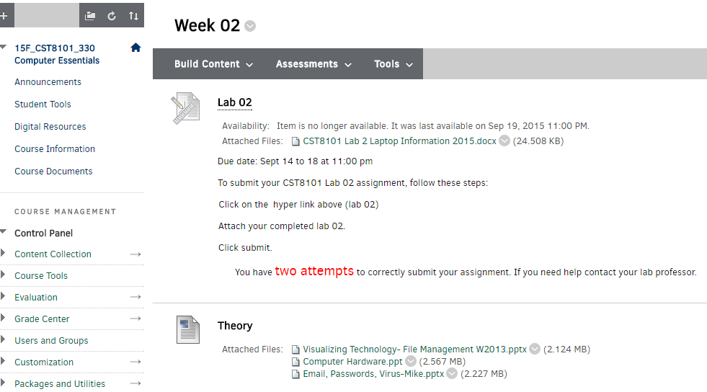
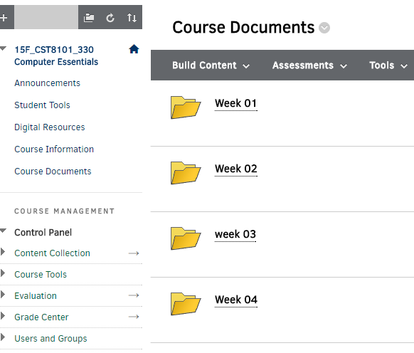
Course Documents

Slide 12
Assignment submission on line
Click here

Slide 13
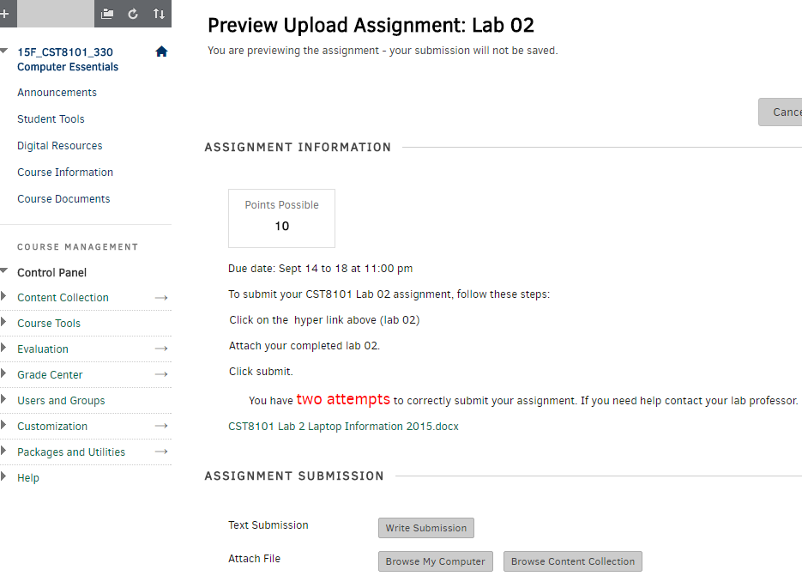

Slide 14
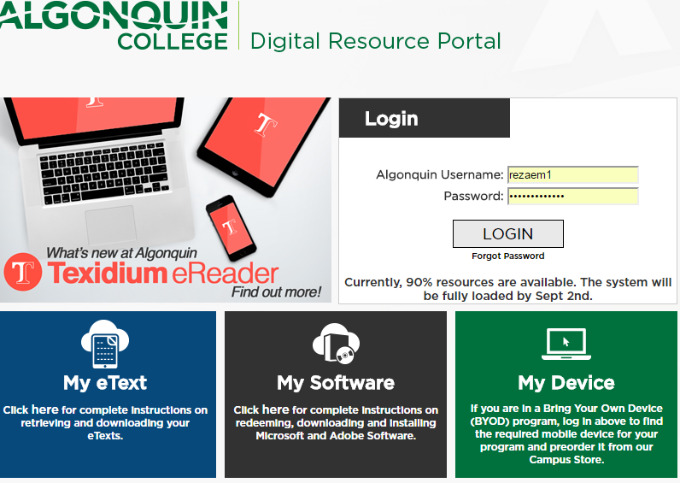
Digital Resource (text book)

Slide 15
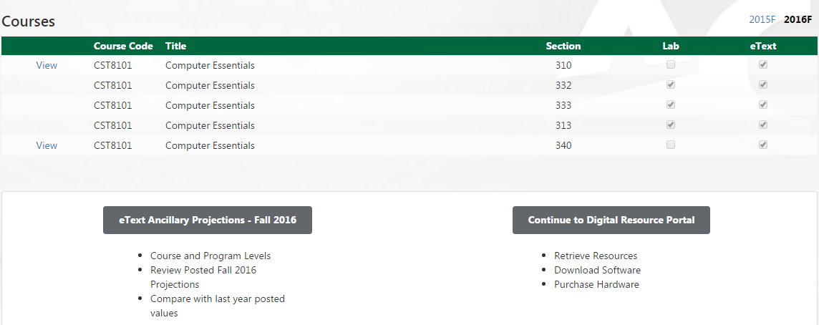
Text book
Click here

Slide 16
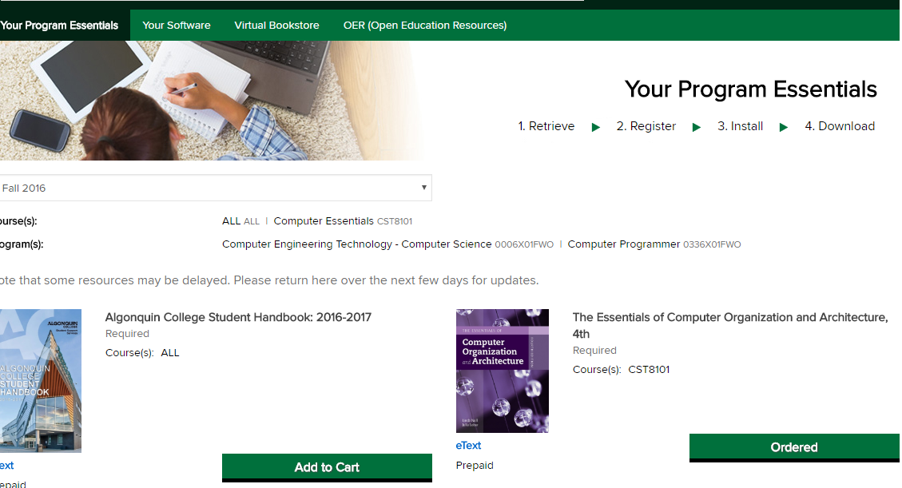
Add to cart

Slide 17
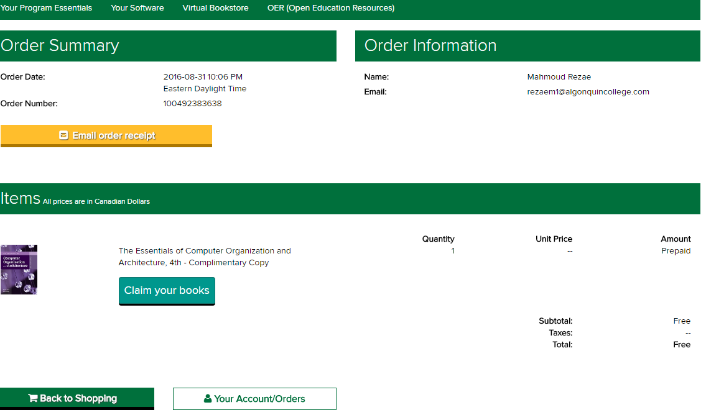

Slide 18
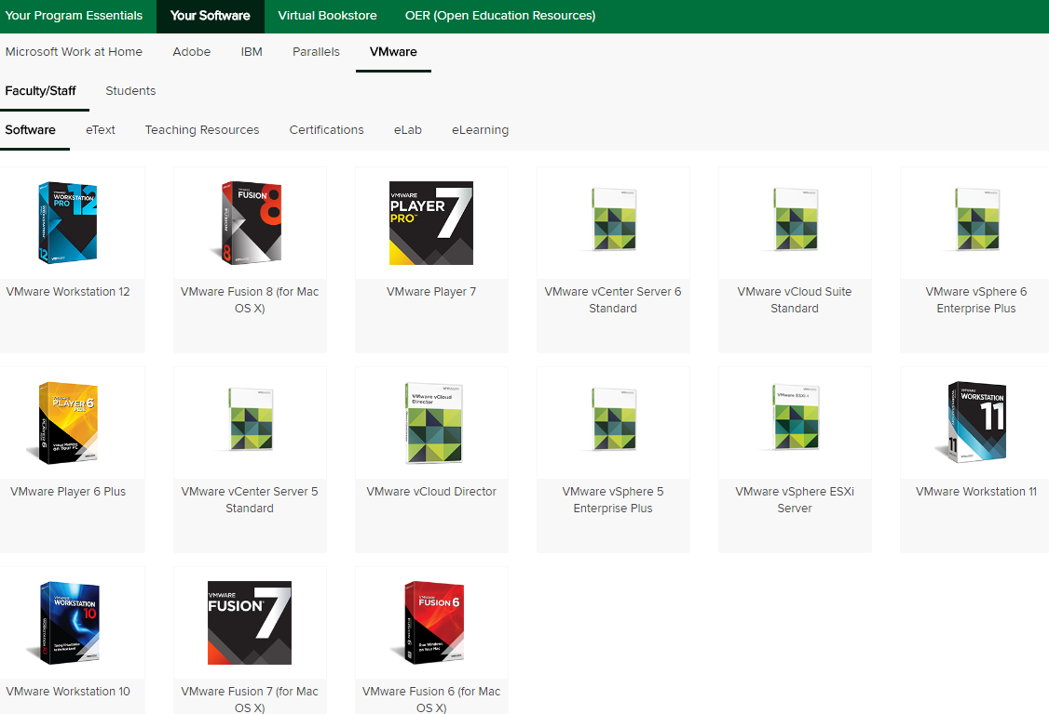
Virtual Machine to download

Slide 19
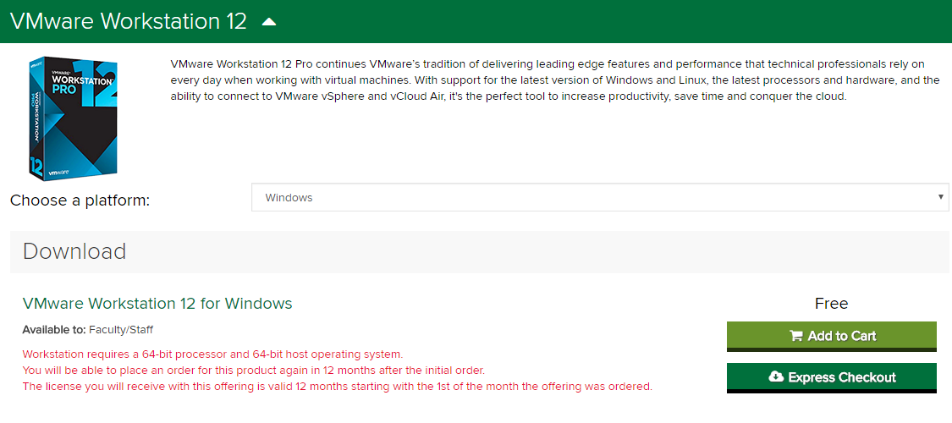
VM work station 12

Slide 20
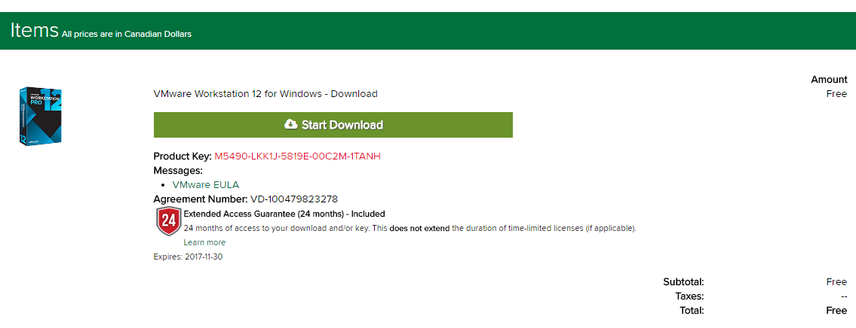
VM 12 VM product key

Slide 21
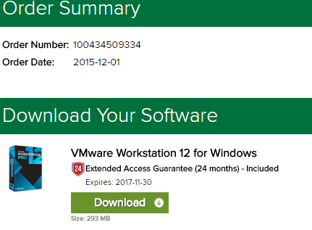
Download

